Slide 1
19K-0314 M.Aashir 19K-1340 Mahnoor 19K-1397 Aneela
FLEX
(schooling management system)

Slide 2
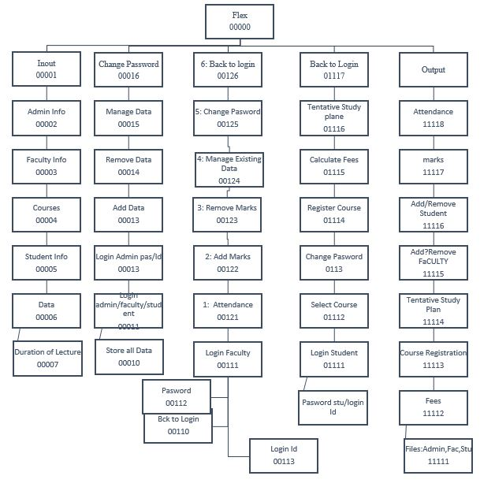

Slide 3
Limitation’s of project and future work:
Our project has some limitation:
We can not se maximum and minimum marks of students of one course so we can add this feature to our project.
We haven't divided students into sections, so we can make sections in future.
After adding marks we are not calculating sgpa( gpa of previous semester).
When we calculate fees we have to enter course code, in future we can make it better.
In “Select Course”, a student will be given option to view all of the data i.e marks or attendance of a specific course.

Slide 4
Contribution of each member:
Aashir:
Store data
Tentitive plan
Marks

Slide 5
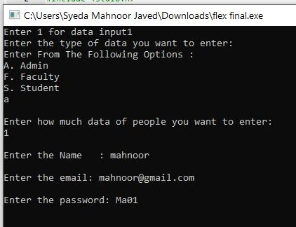
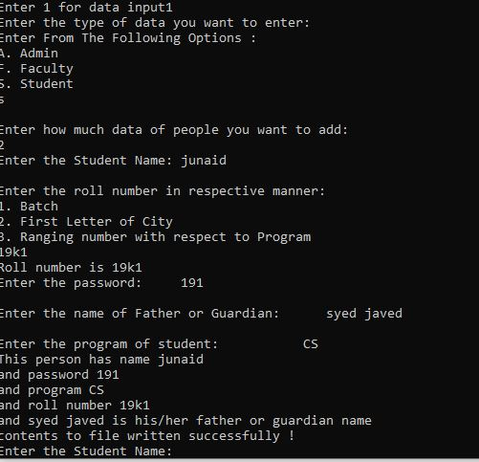
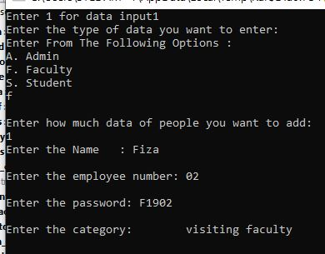
Storing data of faculty, admin and student:

Slide 6
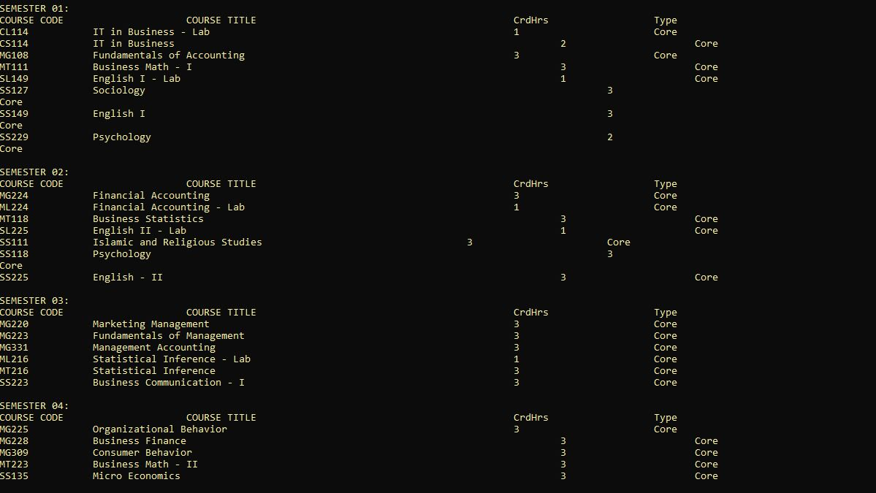
Tentitive Study Plan(1):

Slide 7
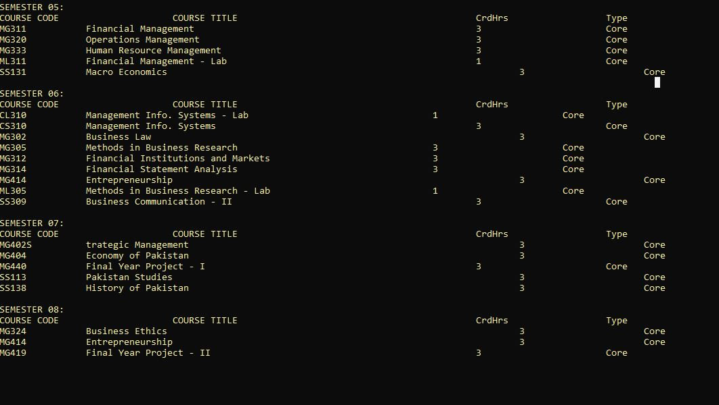
Tentitive Study Plan(2):

Slide 8
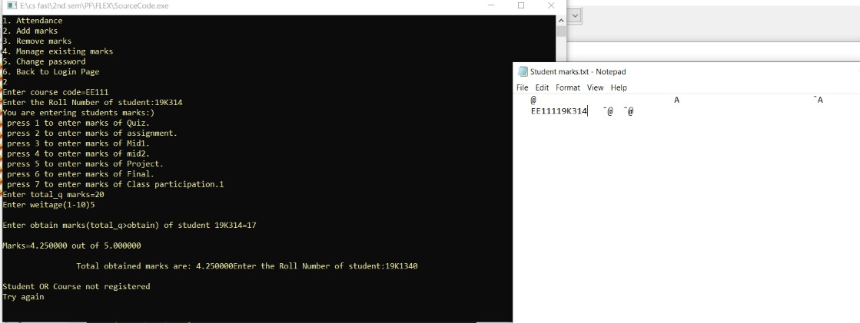
Add marks:

Slide 9
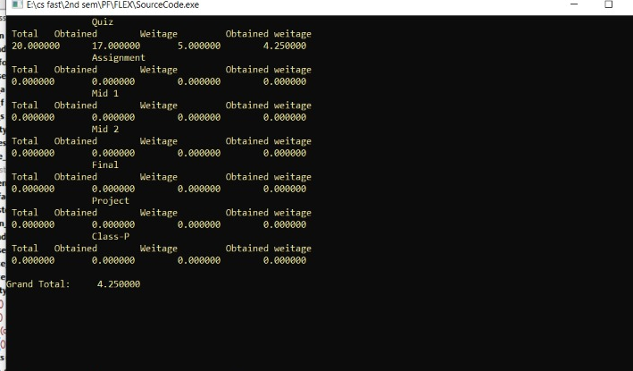
Show marks:

Slide 10
Aneela:
Login
Remove data
Fees

Slide 11
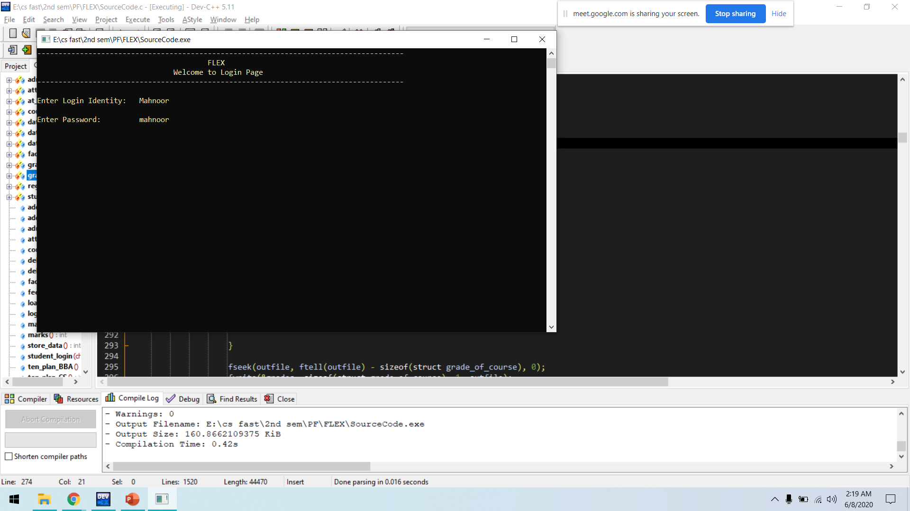
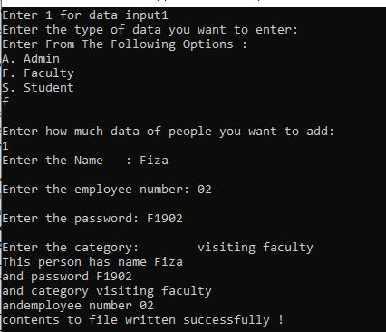
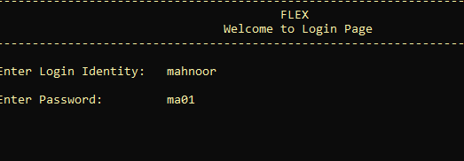
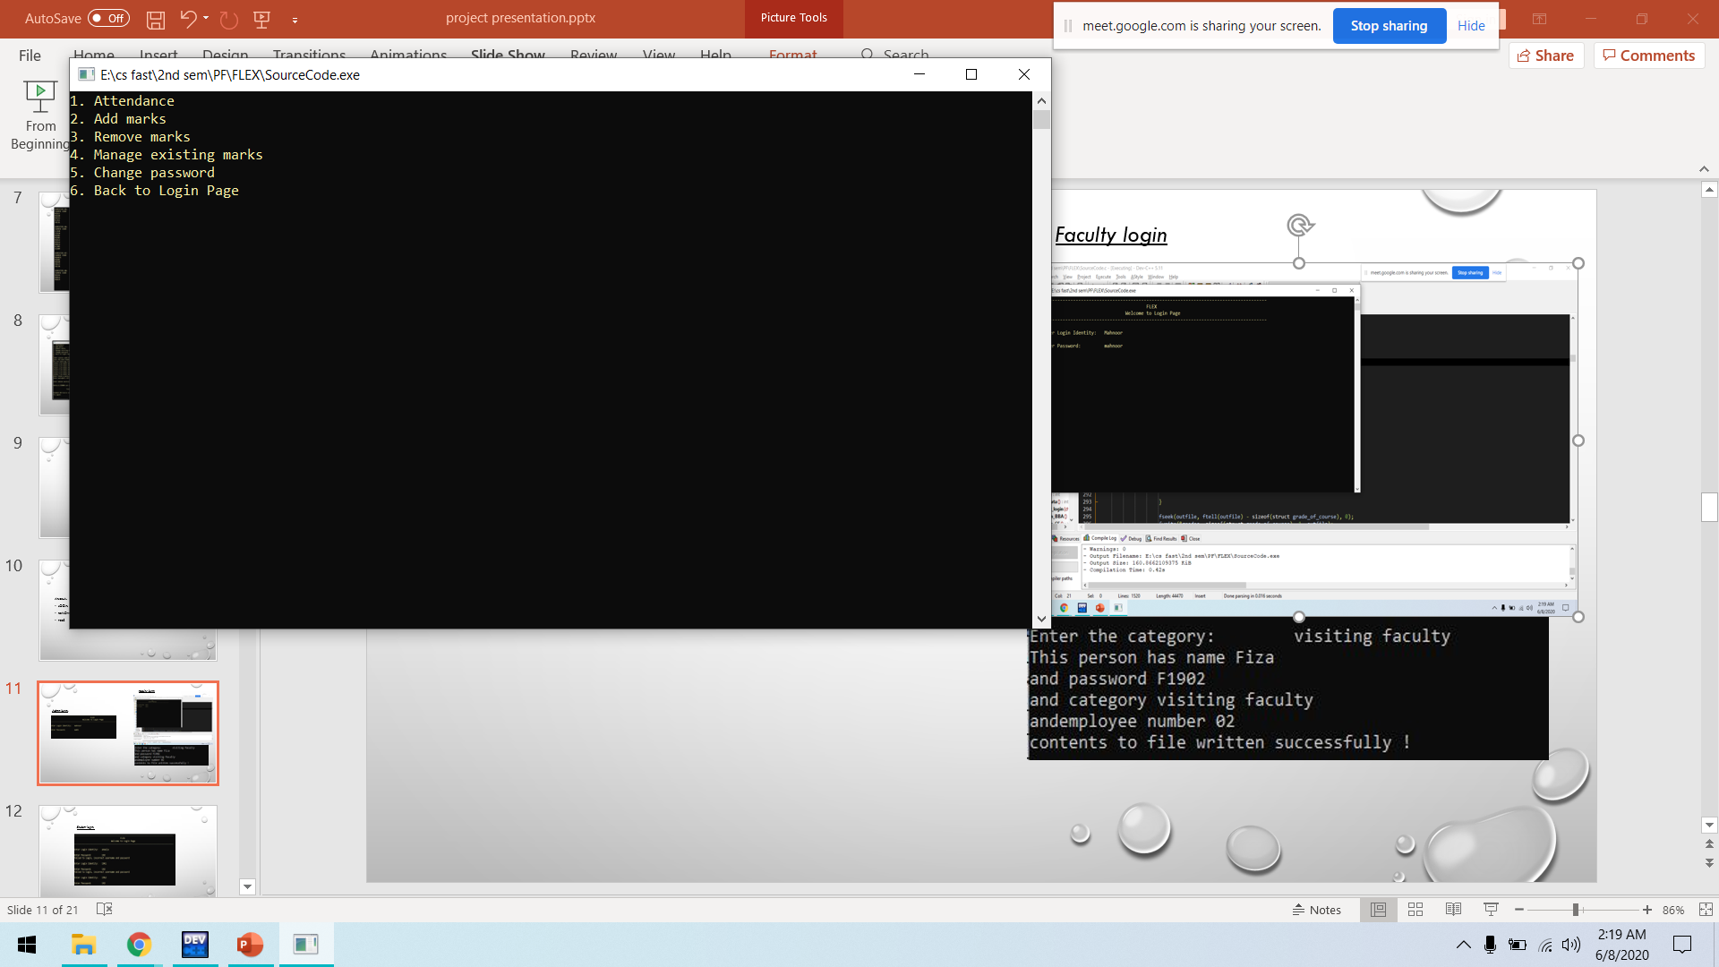
Faculty login
Admin login:

Slide 12
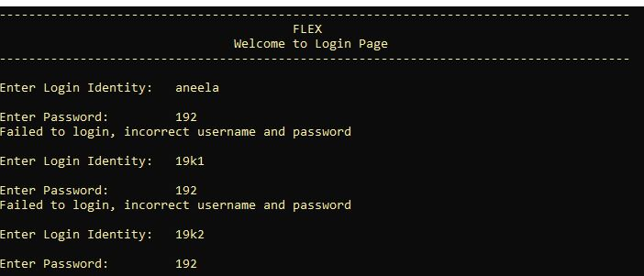
Student login:

Slide 13
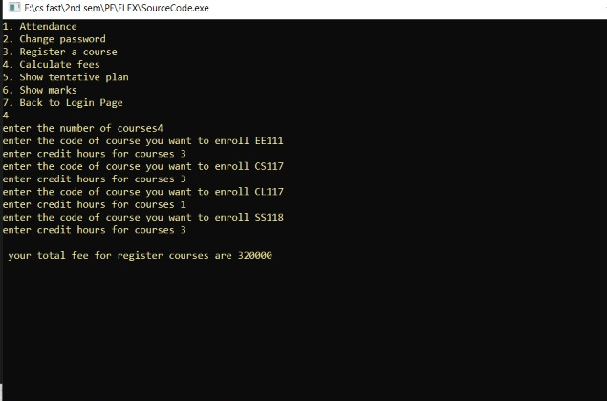
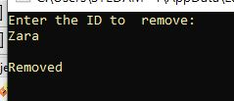
Fees:
Remove data:

Slide 14
Mahnoor:
Change password
Attendance
Course registration

Slide 15
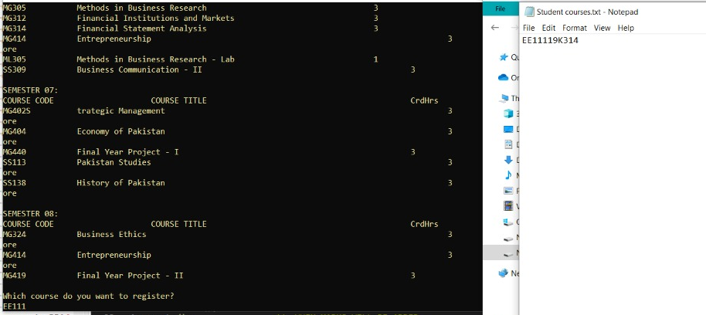
Course registration :

Slide 16
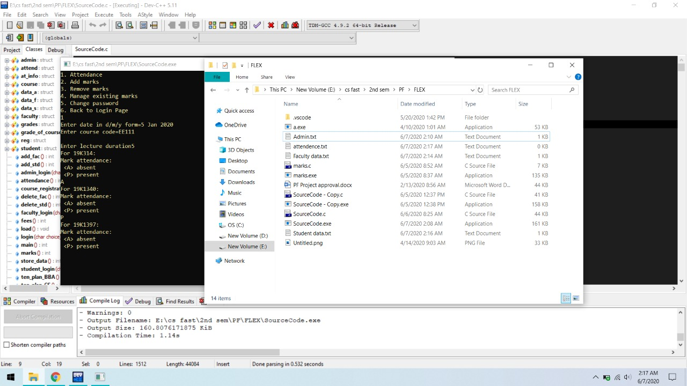
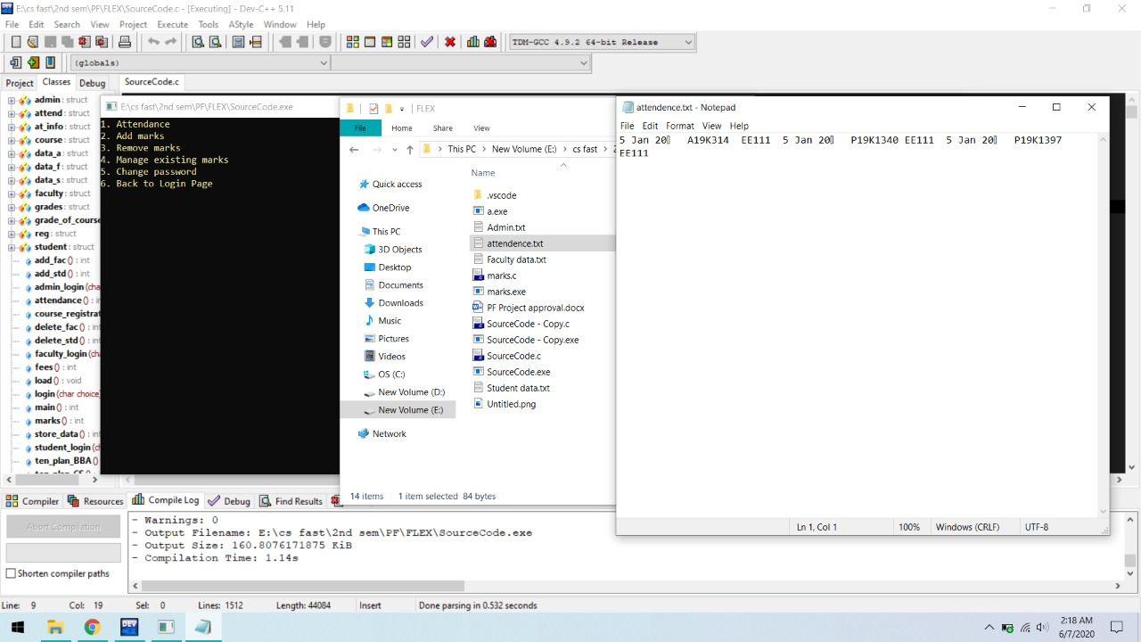
Attendance :

Slide 17
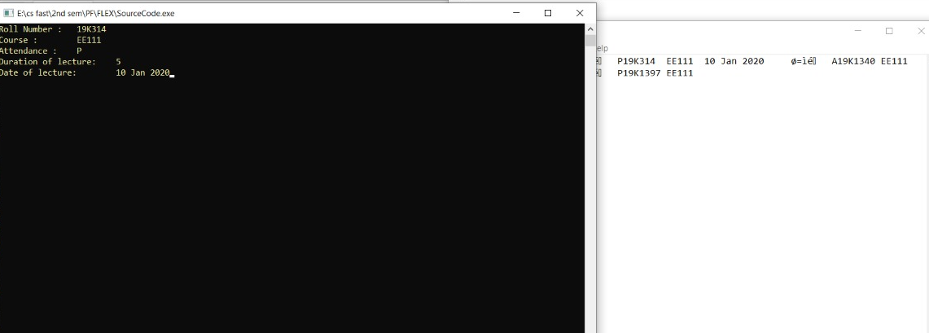
Extract Attendance :

Slide 18

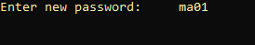

Change password :

Slide 19
lesson learn’t:
We learned to work in team.
We learned to build logic out of nothing, And analyzed how a management works.

Slide 20
Problems and sub problems
We have faced enormous problems while working on project because c is not that advance language but the purpose was to learn to design logics.
1. Problem: We were first storing data in files then we were using those files in program.
Solution: Then we made a separate function of storing data. Where we store all the information in respective files through structure.
2. Problem: we made a function login but it was only working for student.
Solution: we then made separate functions for admin, faculty and students and built logic.
3. Problem: we had a problem in changing password when we were reading a file and roll number matched with input we were changing another data.
Solution: we used fseek and minus one structure’s size from the current position of pointer.

Slide 21
Problems and sub problems
4. Problem: we had to use student roll number for almost every function and for course registration and we had to use only the range of roll numbers.
Solution: to solve this problem we divided our roll number into three parts i-e 19(batch) k(city) and range(0001) and concatenate them into roll number using strcat function.

